Slide 1
Trends Of Digital Payment In Indian BankingSystem For Last Five Years
Presentation By
Anubha Gupta

Slide 2
Content
Introduction
Evolution of Digital Banking Service In India
Methods Of Digital Payment
Past Trends Of Digital Payments In Indian Banking System
Present Scenario 2020
Literature review
Research Problem
Research Design/Methodology/Approach
Sample & data Collection
Research Objectives
Hypothesis Formation
Key Findings
Suggestions
Conclusion

Slide 3
Introduction
Digitalization is the conversion of data into a digital form with the adoption of technology.With other sector, banking is also all around the globe shifting towards digitalization.
Digital banking transactions are growing at a rapid pace with the advent of technological advancements and applications in Indian banking sector.
In Present Time , Banking transaction scenario has changed rapidly from typical to convenience banking, which offers enormous opportunity to move towards cashless and less cash society.
Total transaction value in the Digital Payments segment amounts to US$69,168m in 2020.
Total 589.5m users of Digital transaction has been recorded.

Slide 4
Introduction Continue.....
Due to the rapid growth of the digital payment / transaction in India , the research study on “Trends Of Digital Payment In ndian Banking System For Last Five Years” has to be conducted .
This study will be helpful to knew about the current highly preferable digital payment mode & challenges and future opportunities for Indian banking system .
Present study aims at understanding the preferance , attitute , awareness about digital payment methods in India & also know about the challenges & opportunities for the Indian Banking System inIndia.

Slide 5



Evolution of Digital Banking Service In India
Transformation of traditional
channels ATM, Telephonic,
Branch
Wave 01
Social, Mobile,
Analytics and Cloud led
Transformation
Transformation due
To new digital tech
Such as AI, IOT,
Blockchain, RPA,
API Banking
Wave 02
Wave 03

Slide 6
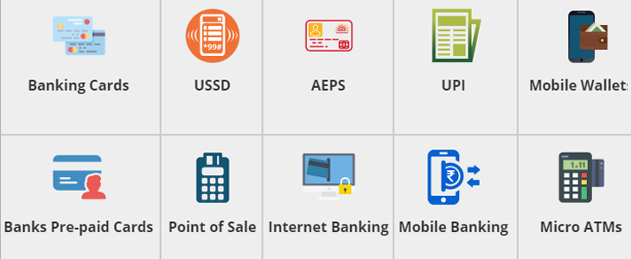
Methods Of Digital Payment

Slide 7
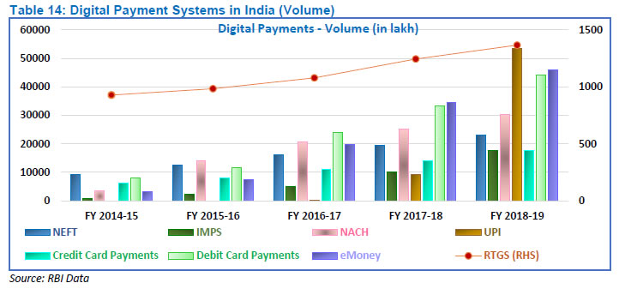
Past Trends Of Digital Payments In Indian Banking System

Slide 8
Present Scenario 2020
The market's largest segment is Digital Commerce with a total transaction value of US$57,574m in 2020.
Total transaction value in the Digital Payments segment amounts to US$69,168m in 2020.
Popular payment channel UPI, which in 2020 has been constantly scaling over 1 billion monthly transactions, processed 99 crore transactions worth Rs.1.5 lakh crore in April, as per data released by NPCI on twitter.
It is recorded 12 crore transactions worth Rs.1.21 lakh crore in April, NPCI data showed.

Slide 9
Literature review
Sanghita Roy, Dr. Indrajit Sinha (2014), stated that E- payment system in India, has shown tremendous growth, but still there has lot to be done to increase its usage. Still 90% of the transactions are cash based. Technology Acceptance Model used for the purpose of study. They found Innovation, incentive, customer convenience and legal framework are the four factors which contribute to strengthen the E- payment system.
Rakesh H M & Ramya T J (2014) in their research paper titled “A Study on Factors Influencing Consumer Adoption of Internet Banking in India” tried to examine the factors that influence internet banking adoption. It is found that internet banking is influenced by its perceived reliability, Perceived ease of use and Perceived usefulness.
Santiago Carbo - Valverde (2017) the article entitled “The Impact on Digitalization on Banking and Financial Stability”. In this article an attempt has been made to discuss the impact of digitalization on banking activities and challenges that imposes for financial stability. The study found that, digitalization is an opportunity to reduce marginal costs and increase productivity in financial services.

Slide 10
Literature review
SHAMSHER SINGH conducted “ A Study on Consumer Perception of Digital Payment Mode”. Main aim of this study was to find out the customer perception and impact of demographic factors on adoption of digital mode of payment.In this study ANOVA analysis indicate that there is no significant variance in consumer perception based on the demographic factors such as gender, age, profession and annual income of the patients. However education was found to significant influence for adoption of digital payment.
Vijayalakshmi B,Sri Padmavati Mahila (Visvavidyalayam ,Women’s University)carried out “A STUDY ON DIGITAL TRANSACTIONS IMPACT ON FINANCIAL PERFORMANCE OF BANKING SECTOR WITH REFERENCE TO SBI AND ICICI “.The aim of this study was by identifying technology trends and changes as well as the impact of this digital transactions on the financial performance of the banking sector. In this study, it is found that the digital transactions strongly correlated with Business per Employee of ICICI and SBI. Banks should try to find out the trigger of change. Indian Banks need to focus on swift and continued infusion of technology.

Slide 11
Research Problem
Digital revolution in India has brought paradigm shift in the banking system and financial transactions due to online payment.
This study focuses on users awareness & usage of digital payment systems. & the aim of this study to identify the impact of digital payment system on Indian banking sector & challenges & opportunities of digital-payment system in India.

Slide 12
Research Question
Do you have a bank account?
Do you prefer Digital Banking?
How often you Make digital payments?
From how many years you are prefering Digital banking?
What is your most preferable Digital Payment Mode?
What attributes attract you to use the digital payment modes of banking & how much?
How much aware you are about these digital payment modes.
What is your biggest concern around digital payments?
What can be safely shared when you make digital payments?
Do you store card details in phone or laptop?
In your opinion, what are the challenges of digital Payment system in banking in India ?
In your opinion, what are the Opportunities of digital Payment system in banking in India ?

Slide 13
Research Design/Methodology/Approach
Present study is a mixed approach of two research strategies; Exploratory & Descriptive research, data was collected from the respondents in Shahjahanpur and Bareilly or Lucknow city with the help of structured Google questionnaire.
Data gathered through the survey was analysed and interpreted with the help of SPSS V. 20 software and tested by statistical tools like: Frequency distribution and One-way ANOVA.

Slide 14
Sample & data Collection
For present study , the structured Google questionnaire was to be carried out to elicit the required information from the customers of different areas in Lucknow , Shahjahanpur and Bareilly.
Quantitative data was collected from a self-administered Google questionnaire.
Information was also gathered through questionnaire about Perception, opinions, awareness, knowledge and of the users of Digital Payment Modes & decision making Attributes/factors & past trends of digital payment from the secondary data also.
Pilot survey was to be carried out on a sample of 15 respondents. Descriptive and frequency testing was employed on the quantitative data.

Slide 15
Sample & data Collection
In the present study ,Convenience sampling technique has been applied based on the parameters of interest, an optimum sample size of 150 respondents was selected to full-fill the sample requirements of representation, flexibility and reliability.
Out of 150 questionnaires 126 response received, 1 questionnaire was incomplete hence it was not considered for analysis. In total 125 questionnaires were found suitable to conduct final analysis.
The survey was conducted during 15 May to 26 May ( 2020) .

Slide 16
Research Objectives
To study the growing trends of digital payment & it’s performance in India through various modes for last Five years.
To study the most preferable digital payment mode among customers.
To study the awareness and usage of digital payment systems among customers.
To identify the impact of advanced digital payment system on Indian banking system.
To identify the challenges & opportunities of digital-payment system in India.

Slide 17
Hypothesis Formation
H0 - There is a significant difference between awareness of different digital modes & preference or usage pattern by the users.(Rejected)
H0 - There is a significant difference between awareness of digital payment modes & status of usage of digital payments or most preferable digital payment mode.(Rejected)
H0 - There is no impact of reasons of using the different digital payment modes on Preference of Digital Banking by the users. (Rejected)
H0 - To identify the most preferable digital payment mode by the users.(Rejected)
H0 - To identify the biggest concern of users around digital payments.(Rejected)

Slide 18
Findings
According to the study of last 5 years growth trends of digital payment from 2014 to 2019 in India. & we found that Digital payment/transaction is growing year by year in India. & most of the people are using UPI (Unified payment interface) for their digital Transaction more than other digital payment method.
According to this study it is found that 96% respondents having a bank account and 94 % respondents prefer digital banking.
By this study it is found that most of the people using digital payment /transaction 36% on weekly basis & 23 % people on daily basis. The ratio of using digital payment are growing day by day due to the easiness or the growth digitalization in Indian banking system in India.

Slide 19
Findings Continue...

Slide 20
Findings Continue...

Slide 21
Findings Continue...

Slide 22
Findings Continue...

Slide 23
Findings Continue...

Slide 24
Findings Continue...

Slide 25
Suggestions
The opportunities (High Internet Penetration, Highly Usage of Smart phone,, Initiatives of Government , Increasing E-Commerce ,digital banking solution, untapped rural market ) can availed efficiently and the challenges can be easily counter balanced by adopting more innovative solutions and technological, security measures.
In current scenario Banks should take effective measures in creating more awareness towards the effective usage of technology and security and techniques of using digital payment modes.

Slide 26
Conclusion
Digital banking has become popular that moves in golden pace with the advent of digital revolution. The study conclude that 96 %of the respondents are using digital banking now days & mostly preferring the UPI in India. The study also gives emphasis to the percentage of awareness on maximum utilization of technology and different digital payment methods or reasons for using it.

Slide 27
Thank You

